Slide 1
ST. JOHN BOSCO CORE PTC-LODONGA
COLLEGE PROFILE AND STATUS
By
Fr. Hillary Kago Orwinya
(Principal)

Slide 2
GEOGRAPHICAL LOCATION
The College has a designated piece of land duly leased by the proprietor (Arua Diocese). The land it owns is 36,000 acres. Area covered by the existing structures is 9.53 acres.
The College is located in Basilica Cell, Rembeta Ward, Lodonga Town Council, Aringa South Constituency, Yumbe District.
It is 75.1 kilometres North of Arua Town and 522 kilometers from Kampala via Masindi.

Slide 3
HISTORY
It was founded on 31st January, 1945 by Fr. Peter Traversi solely to train gentlemen (single sex College).
Prior to its foundation, the teacher trainees from West Nile region had their training in Lira.
The College started as a National Teachers’ Centre by Comboni Missionaries to train Grade 1 Teachers.
It was envisaged to cater for the Local Language Lugbara ti and Ma’di since the Teacher Trainees from West Nile had problems with Luo Language

Slide 4
GROWTH OF THE COLLEGE
The College developed and progressed from VTT College to Grade Two (11) in 1956, Grade Three (111) in 1986 and became co-educational in 1992.
In July 2001, the College was elevated to the status of Core PTC to handle both Pre-service and Outreach programmes.

Slide 5
SET BACK
The wars of the 1980s during which all buildings of the College were raged down and many documents destroyed.
In 1999 when Government withdrew its Grant in- Aid. The College operated for one term as a Private PTC
His Excellency the President of the Republic of Uganda, Yoweri Kaguta Museveni, reinstated the Grant-in-Aid in the same year.

Slide 6
PRINCIPALS SINCE THE ESTABLISHMENT OF THE COLLEGE
S/N | Name of Principal | Period of service | College status
1 | Fr. Peter Traversi | 1945 to 1950 | Grade 1
2 | Fr. Igino Albrigo | 1951 to 1952 | Grade 1
3 | Fr. Luigi Ponzoni | 1953 to 1956 | Grade 1
4 | Fr. Andrea Minisini | 1956 to 1958 | Grade 11
5 | Fr. Eltore Pedrini | 1958 to 1985 | Grade 11

Slide 7
PRINCIPALS SINCE THE ESTABLISHMENT OF THE COLLEGE CON’T
6 | Mr. Ajuamani Basil | 1985 to 1985 | Grade 111
7 | Mr. Drate Wilson (Caretaker) | 1985 to 1996 | Grade 111
8 | Mr. Obwona Peter | March 1996 to October 1996 | Grade 111
9 | Rev. Fr. Odubuker Picho Epiphany | 1996 to 2010 | Grade 111
10 | Rev. Fr. Orwinya Hillary Kago | 2010 to date | Grade 111

Slide 8
COLLEGE PHILOSOPHY
1. Motto; Dominus Illuminatio Mea;
Meaning; “The Lord is my Light”
2. Vision; To be an Institute of Distinction
3. Mission Statement:
To Mold a Transformative, Proficient, Responsible, Committed and Dedicated, God fearing, Professional Teachers of High Moral Integrity with the 21st century skills.
4. The core value; Integrity, Honesty, Equity and Professionalism

Slide 9
COLLEGE OBJECTIVES
To enhance an active and productive Teaching and learning process.
To organize and implement effective CPDS, workshops, Pre-service and Outreach programs, tutorials, seminars, team teaching, demonstration lessons and community mobilization.
c) To engage the teacher trainees in tasks and duties that develop in them a sense of responsibility, commitment and dedication

Slide 10
OBJECTIVES CON’T
d) To instill in the teacher trainees moral values.
e) To network and collaborate with other stakeholders

Slide 11
BOARD OF GOVERNORS (BOG)
S/N | NAME | SEX | CONSTITUENCY
1 | Msgr. Asega Primus | M | Foundation body
2 | Rev. Fr. Idraku Charles | M | Foundation body
3 | Ms. Aliru Lucy | F | Foundation body
4 | Mr. Ezadri Michael Onyafia | M | Foundation body
5 | Ms. Ocokuru Roselyn | M | Foundation body
6 | Mr. Buga Mustafa | M | Local Council Representative
7 | Ms. Aduyo Zakia | M | Local Council Representative

Slide 12
LIST OF BOG CON’T
S/N | NAME | SEX | CONSTITUENCY
8 | Ms. Andile Grace | F | Parents representative
9 | Mr. Eyia Opal Abua Palma | F | Parents representative
10 | Mr. Mawadri Geofry Boko | M | Staff representative
11 | Mr. Bayo Augustine | M | Staff representative
12 | Mr. Enaku Natal | M | Old Students’ representative

Slide 13
FUNCTIONS OF BOG
Govern the school for which it has been constituted under the Act subject on to any directions which may be given to by the Minister in writing on matters of general policy.
Administer any funds, chattels or things of the school derived by a way of fund-raising or action, on behalf of the school.
Provide for the welfare and discipline of students and fix fees and other charges with the approval of the Minister
Perform such other functions such as prescribed by these Regulations.

Slide 14
INTERNAL ADMINISTRATORS
Principal
Deputy principal Pre-Service (DPP)
Deputy principal Out Reach (DPO)
Director of Studies (DOS)
Heads of Departments (HoD)

Slide 15
FUNCTIONS OF ADMINISTRATORS
The overall administration and management of the college;
a) Planning for the development of the college and professional development of the staff.
b)Controlling the college finances in consultation with the BOG.
c) Supervising the pre-service and outreach staff
d)Admission of students
e)Management of curriculum implementation
f)General College discipline management

Slide 16
FUNCTIONS OF ADMINISTRATORS CON’T
g)Coordinating the functions of the BOG and accounting to the BOG.
h)Accounting to the MOES
i)Preparing annual confidential report on the college staff and carrying out staff performance appraisal.
j)Teaching students

Slide 17
TOOLS OF ADMINISTRATION
Constitution of Uganda
Public service standing order
Professional code of conduct.
Circulars
Policies – guidelines
Education Act – 2008Rules and Regulations
CPDs – on capacity building.
Schemes of service – Ladders
Strategic plan and development plan.
Workshop plans.
Timetables

Slide 18
CURRENT TEACHING STAFF, ACADEMIC QUALIFICATION AND SUBJECTS OF SPECIALIZATION
S/N | Name | Sex | Designation | Qualification | Subject Specialization
1 | Rev. Fr. Orwinya Hillary Kago | M | Principal | PGDTE/MAED MMS[HRM] | RS/PES
2 | Nambafu Rose Masolo | F | DPP | M.E.d | LANG/SST
3 | Inziku Robert Pax | M | DPO | M.E.d
4 | Opeto Bonny | M | DOS | MAEP | MTC/PES
5 | Cadribo Rophine | M | Tutor | Graduate | LANGUAGE/MUSIC
6 | Amza Zakaria Anguyo | M | Tutor/SPO | Graduate | SST/PES
7 | Amute Robinson | M | Tutor/CCT | Graduate | IPS

Slide 19
8 | Asea Hulton Basil | M | CCT | Graduate
9 | Munduru Rose | F | Tutor | MAED | Sports Science
10 | Eriku Eric Ark | M | Tutor | Graduate
11 | Okello John Wesley | M | CCT | Graduate | Local Language
12 | Bayo Augustine | M | CCT | Graduate | SST/RE
13 | Bayoa Mariata | F | CCT | Graduate | Science
14 | Adoko Mohammed. A | M | Tutor | DTE | IPS
15 | Drijale Cox Sebastian | M | Tutor | DTE | P.E/PES
16 | Amedi Buzu | M | Tutor | Graduate | Maths/PES
17 | Ivudria Benard | M | Tutor | Graduate | Maths/PES
18 | Wani Gilbert | M | Tutor | Graduate | Maths/PES
19 | Edema Richard Bazil | M | Tutor | M.E.d | PES/MATHS

Slide 20
20 | Waku Peter Henry | M | Tutor | Graduate | PES/SST
21 | Njau Wambui Joyce[Sr] | F | Tutor | Graduate | Kiswahili
22 | Keliki Cecilia (Sr) | F | Tutor | Graduate | ECD DM
23 | Fr. Bongomin Anthony | M | Tutor | Graduate | RE/PES
24 | Ocamgiu Gilbert | M | Tutor | Graduate | SCIENCE DM
25 | Mawadri Geofrey Boko | M | Tutor | Graduate | LAG/RS
26 | Sr. Owachgiu Deogratias | F | Tutor | Graduate | ELE/RS
27 | Atiku Robert | M | Tutor | Graduate | ELE/SSE
28 | Abiriga John Drameri | M | Tutor | Graduate | ISE (DM)
29 | Ijiribi David | M | Tutor | M.E.d | Music (DM)
30 | Mundua Agaal Felix (Bro) | M | Tutor | Graduate | PE/MATH
31 | Aniku Rashid Ahmed | M | Tutor | Graduate | LAN/SST
32 | Amatre Basil | M | Tutor | Graduate | ECD DM

Slide 21
PROFESSIONAL NON-TEACHING STAFF
S/N | Name | Sex | Designation
1 | Mr. Alioma Richard | Male | Senior Accounts Assistant
2 | Sr. Anguparu Theresa | Female | Senior Nursing Officer
3 | Candiga Michael | Male | Stores Assistant
4 | Mr. Sanya George | Male | Laboratory Technician

Slide 22
PROFESSIONAL NON-TEACHING STAFF CON’T
S/No | Name | Sex | Designation
5 | Amaniyo Susan | Female | Stenographer
6 | Likicho Alice | Female | Office Attendant
7 | Opiya Florence | Female | Waitress

Slide 23
LIST OF SUPPORT STAFF
S/N | Name | Sex | Designation
1 | Opiya Florence | F | Waitress
2 | Angu Patrick | M | Cook
3 | Letiyo Clara | M | Waitress
4 | Atimaku Lilian | F | Waitress
5 | Dropia Letisia | F | Waitress
6 | Anyecuanyi Samuel Erwaga | M | Cook

Slide 24
FUNCTIONS OF PRE-SERVICE
Teaching
mentoring and coaching
assessing
support supervising
lesson planning and scheme of work preparation
guidance and counseling students
participating in co-curricular and community activities
keeping and maintaining clean records

Slide 25
FUNCTIONS OF PRE-SERVICE CON’T
preparing and use of appropriate instructional materials
conducting tutorials
set, administer and mark examinations
conducting CPDS, seminars and workshops.

Slide 26
OUT REACH TUTORS
COORDINATING CENTRE TUTORS(CCT)

Slide 27
OUT REACH CATCHMENT AREA
S/N | DISTRICT | CC | NAME OF CCT | CONTACT
1 | YUMBE | KURU | AMATRE BASIL | 0781235561
2 | YUMBE | NYOKO | ERIKU ERIK ARK | 0782781592
3 | YUMBE | LOBE | EKELLO JOHN WESLEY | 0772242181
4 | YUMBE | ELEKE | AMEDI BUZU | 0772901787
5 | ADJUMANI | BIYAYA | TUMBA JIMMY | 0772345952
6 | ADJUMANI | AJUGOPI | BAYO AUGUSTINE | 0772993536
7 | ADJUMANI | ODU | TUMBA JIMMY | 0772345952

Slide 28
OUT REACH CATCHMENT AREA CON’T
S/N | DISTRICT | CC | NAME OF CCT | CONTACT
8 | ADJUMANI | UKUSIJONI | IVUDRIA BENARD | 0774776097
9 | TEREGO | OTUMBARI | AMUTE ROBINSON | 0782835006
10 | KOBOKO | NYARILO | ANIKU AHMED RASHID | 0784215822
11 | KOBOKO | GOYA | ASEA HULTON BASIL | 0772655255
12 | MOYO | LAROPI | BAYOA MARIATA | 0765441208
13 | MOYO | MOTO T/C | BAYOA MARIATA | 0765441208
14 | OBONGI | OBONGI | FR. AYUU ARCHANGELO | 0772623748

Slide 29
FUNCTIONS OF OUTREACH TUTORS (CCT)
Enhancing regular supervision, mentoring, coaching
Organizing Centre-based or school-based CPDS for head teachers, teachers, SMCs, and PTA.
Supporting classroom teachers.
Organizing PGMs and peer review meetings
Ensuring policies are implemented.
Writing and submitting reports.
Collecting data.

Slide 30
FUNCTIONS OF OUTREACH TUTORS (CCT) CON’T
Networking with various stakeholders.
Teaching in the pre-service.
Creating functional resource centers.
Community mobilization
Mentoring and coaching head teachers and teachers

Slide 31
PROGRAMS IN THE COLLEGE
Grade III Teachers’ Certificate. (GIII)
Diploma in Early Childhood Education (DECE)
Diploma in Early Childhood Education (DEC)
Diploma in Education Primary External (DEPE)
Diploma in Education Primary (DEP)
Bachelor of Education in Primary External (BEBE)

Slide 32
ENROLMENT FOR THE LAST FIVE YEARS
Courses | 2021 |  |  | 2022 |  |  | 2023 |  |  | 2024 |  |  | 2025
 | M | F | T | M | F | T | M | F | T | M | F | T | M | F | T
Grade III (Amnesty retakes) | 100 | 81 | 181 | 00 | 03 | 03 | 09 | 17 | 26 | 04 | 06 | 10 | - | - | -
DECE | - | - | - | - | - | - | 15 | 32 | 47 | 12 | 33 | 45 | 06 | 20 | 26
DEC | 13 | 43 | 56 | 39 | 119 | 158 | 32 | 116 | 148 | 03 | 20 | 23 | - | - | -
DEPE | 86 | 25 | 111 | 31 | 07 | 38 | 32 | 09 | 41 | 22 | 06 | 28 | 22 | 06 | 28
DEP | - | - | - | - | - | - | 85 | 37 | 122 | 81 | 35 | 116 | 60 | 41 | 101
BEBE | 27 | 05 | 32 | 44 | 28 | 72 | 37 | 20 | 57 | 12 | 11 | 23 | 12 | 11 | 23

Slide 33
PROJECTS OF THE COLLEGE
• Cattle keeping
• Biogas digesters
• Afforestation
• Orchard

Slide 34
DEVELOPMENT PARTNERS
UNICEF,
Save the Children International,
Plan International,
World Vision,
Aga Khan Foundation,
Fin Church Aid,
Windle International Uganda,
Norwegian Refugee Council,
IRC and Danish Refugee Council.
War Child Holland

Slide 35
KEY ACHIEVEMENTS
Over the years the college has successfully implemented the following;
Grade III Teachers certificate from 1986 to 2022 by Kyambogo University
ECD Certificate from 2012-2016 (DECE)
Diploma in Early Childhood Education Diploma in Early Childhood Education (DEC) 2016 to date
Diploma in Education Primary External (DEPE)
Diploma in Education Primary (DEP)

Slide 36
KEY ACHIEVEMENTS CON’T
Bachelor of Education in Primary External (BEBE) from 2021 to date by Kyambogo University
Academic and professional excellence of the teacher trainees
The college has positioned herself as one the best among others nation wide since 2000
Effective out reach department through collaboration and networking with all stake holders
Effective collaboration with MoES, KyU, Local government and all education development partners.
Establishment of Maker-Space

Slide 37
KEY CHALLENGES
Inadequate library space
Inadequate ICT facilities
The transition challenges eg. Grade III Teachers Training to diploma Program
In the out reach, means of transport and dilapidated structures

Slide 38
WAY FORWARD
The college should Lobby for construction of a new state of the Art Library
The MoES should augment college effort in securing more ICT facilities
The MoES should effectively manage this transition to give sense of direction
The MoES should lobby for funds for procurement of motorcycles and renovation of CC structures
There an idea of establishing a pedagogical hub

Slide 39


Slide 40
COLLEGE STRUCTURES

Slide 41
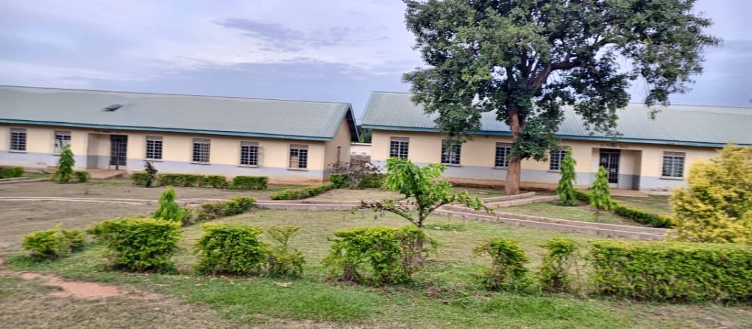
DORMITORIES

Slide 42
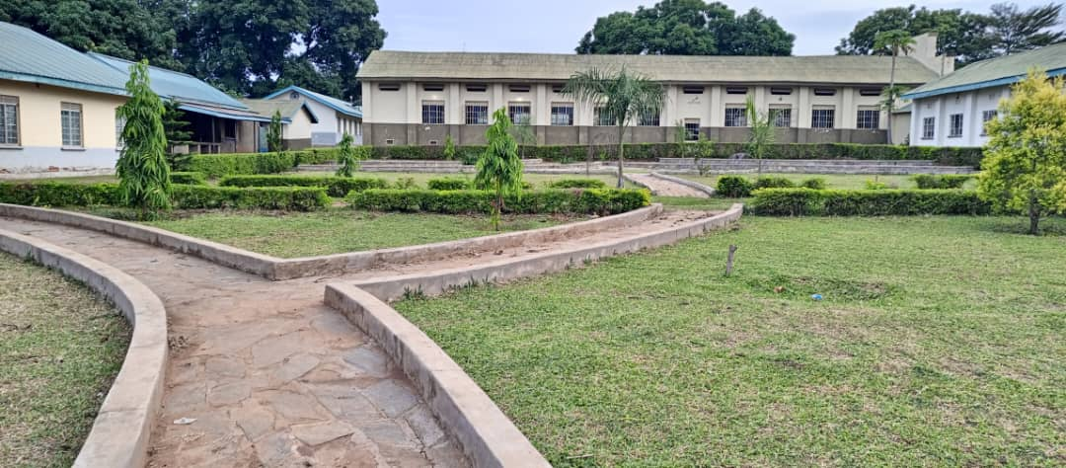
COMPOUND IN FRONT OF THE DORMITORIES AND THE MULTI-PURPOSE HALL

Slide 43
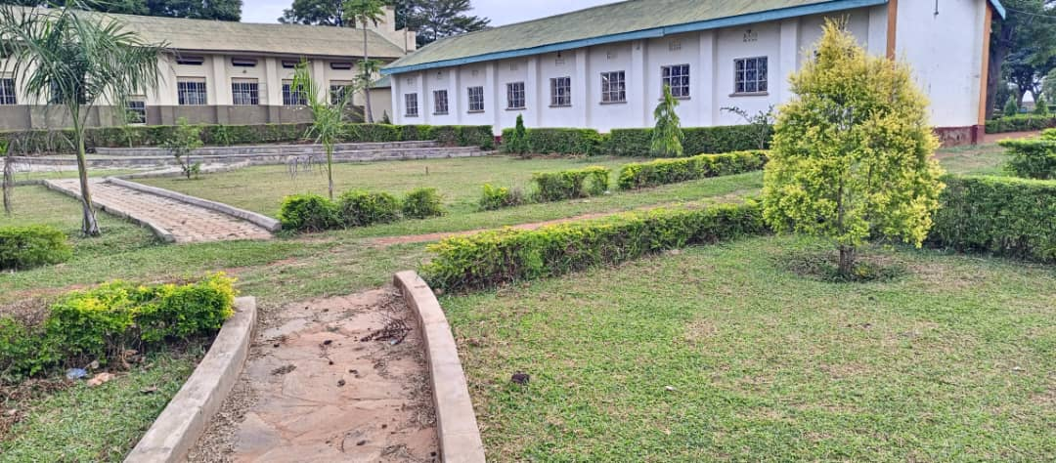
COMPOUND BEHIND THE MULTI-PURPOSE HALL AND DORMITORIES

Slide 44
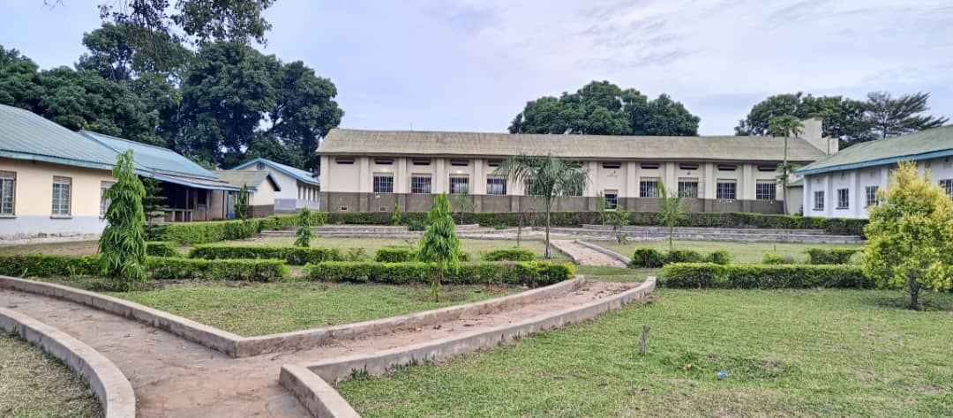
VIEW OF PRINCIPAL’S GARDEN

Slide 45
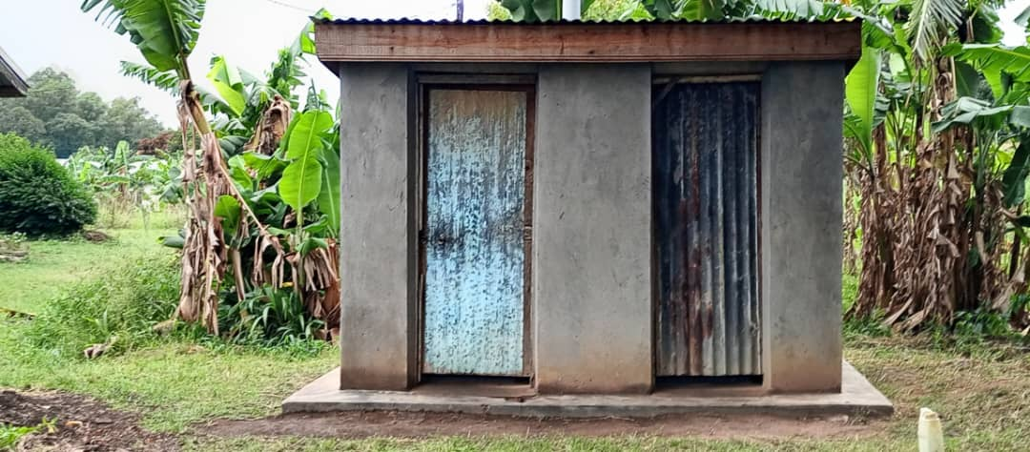
LATRINE IN THE QUARTER

Slide 46
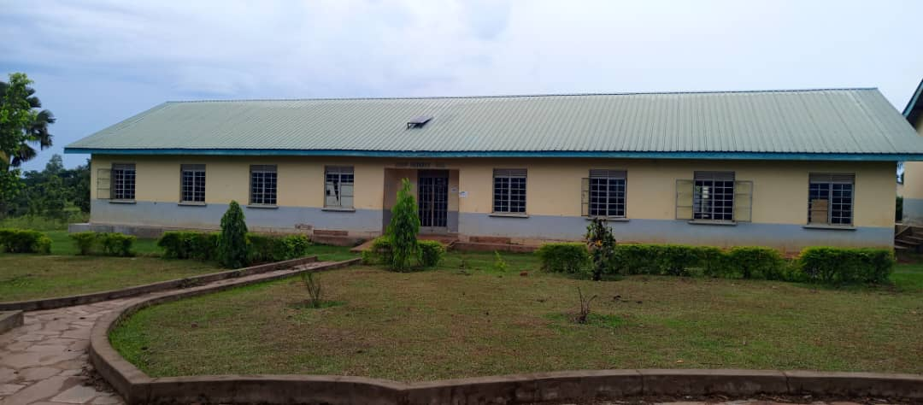
DORMITORY

Slide 47
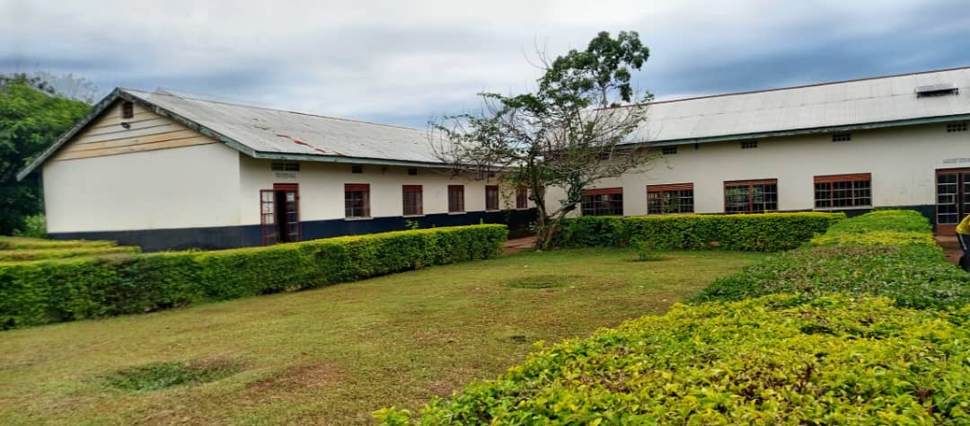
LADIES DORMITORIES

Slide 48
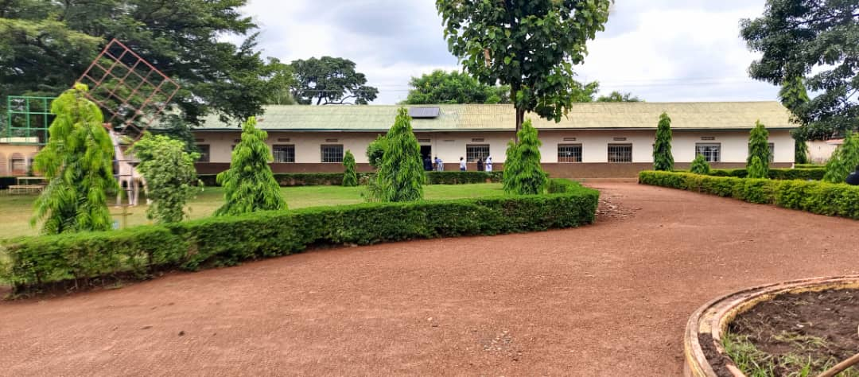
CLASSROOMS

Slide 49
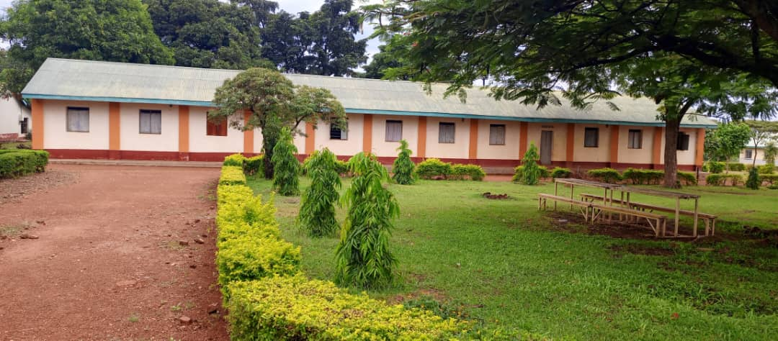
TARANTINO DORMITORY

Slide 50
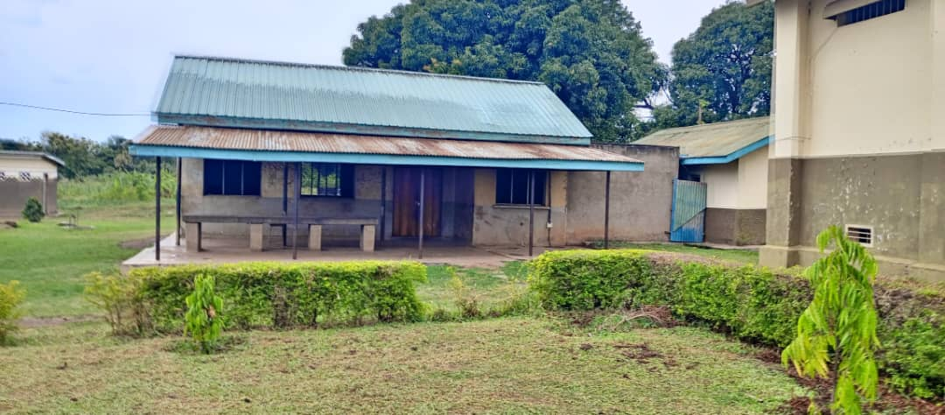
KITCHEN

Slide 51
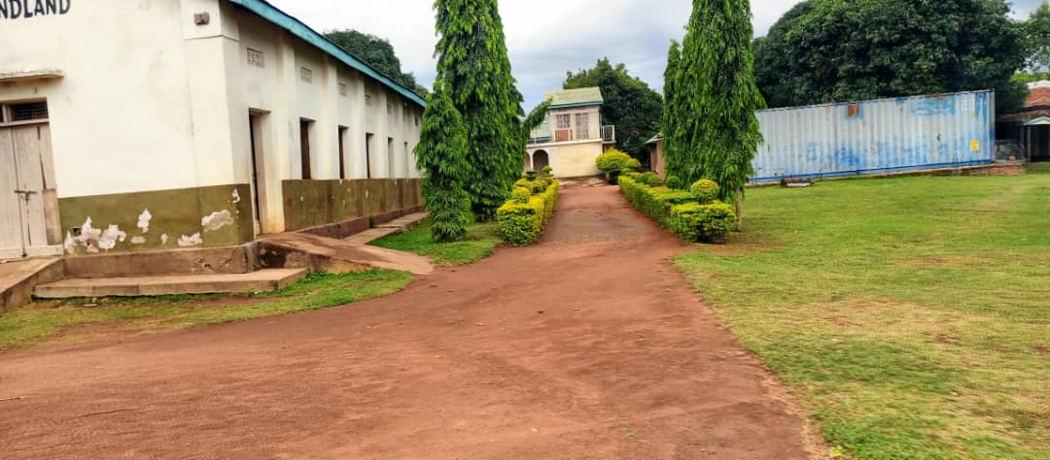
PATH TO CHAPLAINCY

Slide 52
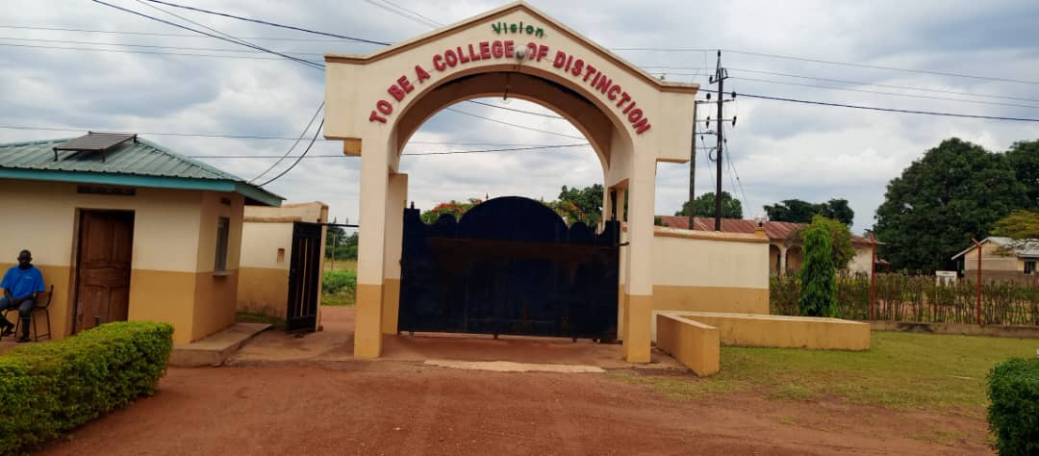
COLLEGE GATE FROM INSIDE

Slide 53
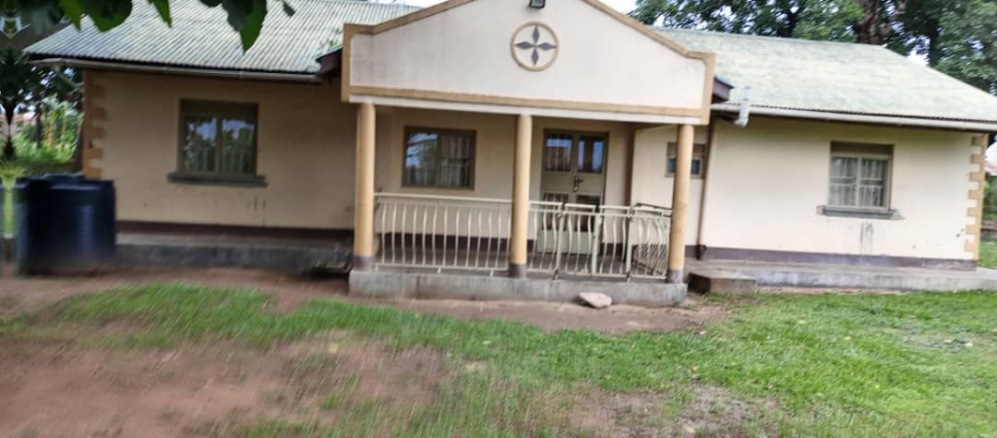
STAFF HOUSE

Slide 54
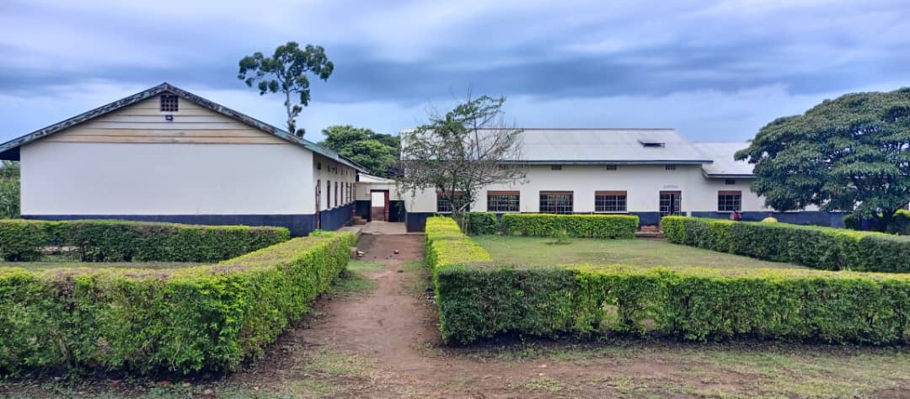
VIEW OF LADIES DORMITORY

Slide 55
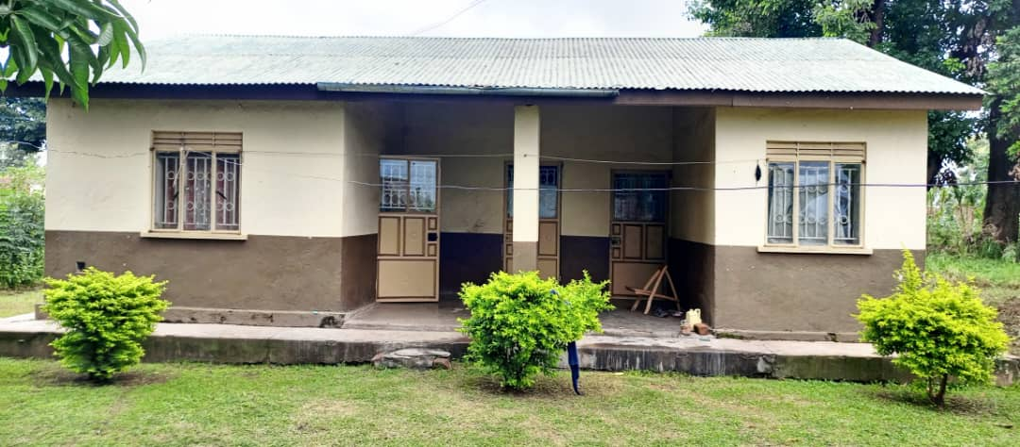
STAFF HOUSE

Slide 56
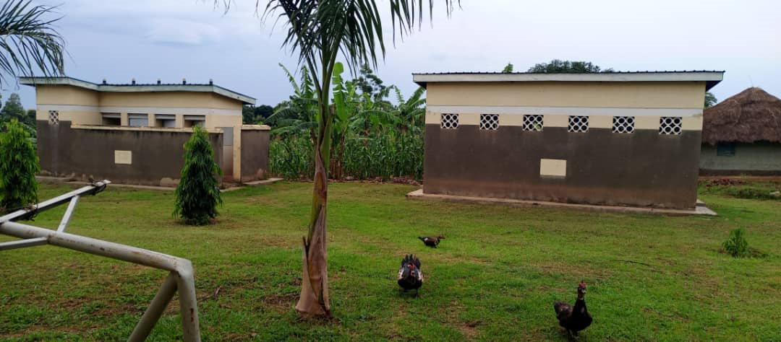
STUDENT’S VIP LATRINE AND BATHING SHELTER

Slide 57
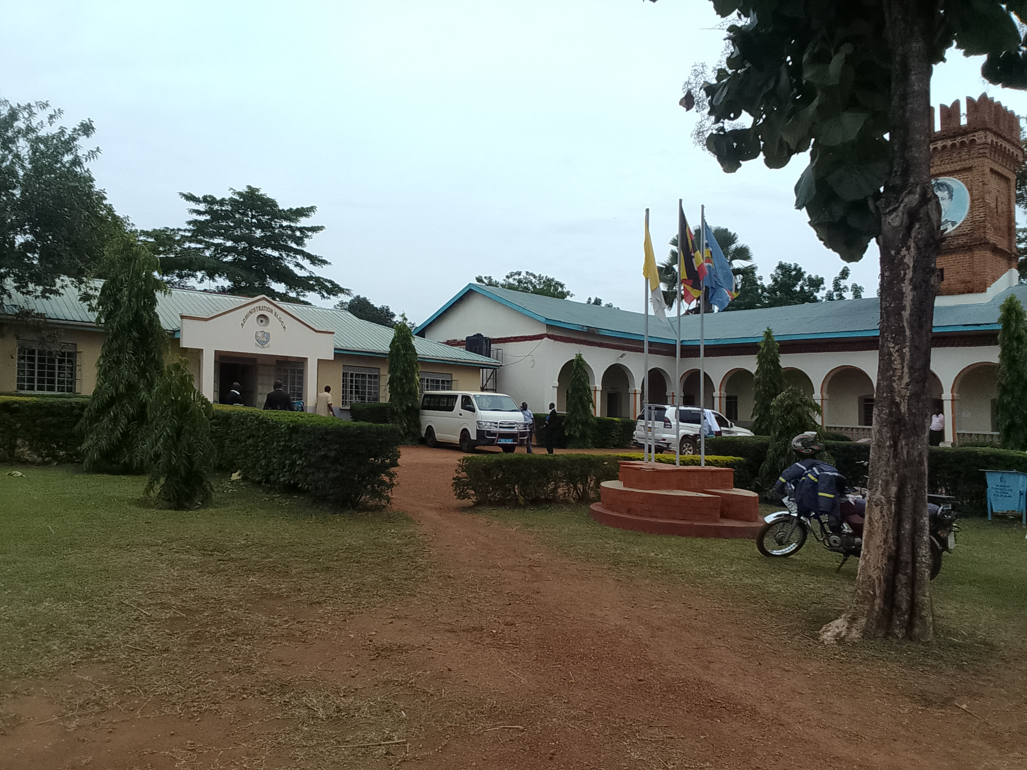
VIEW OF ADMINISTRATION BLOCK AND TUTORIAL BLOCK

Slide 58
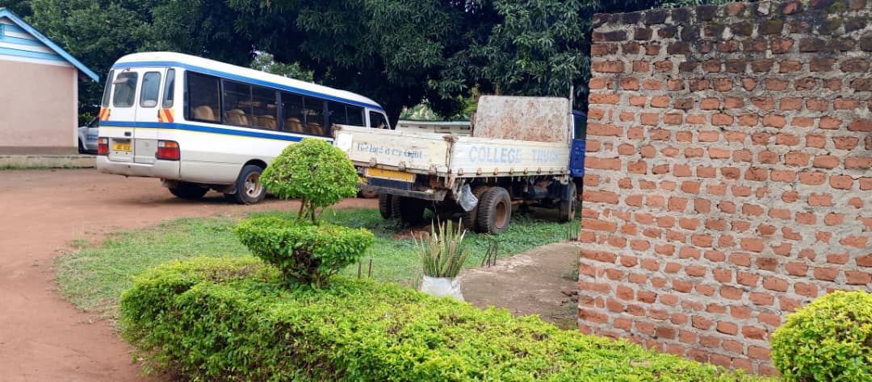
COLLEGE MINI-BUS OLD OUT-OF-ROAD TATA LORRY

Slide 59
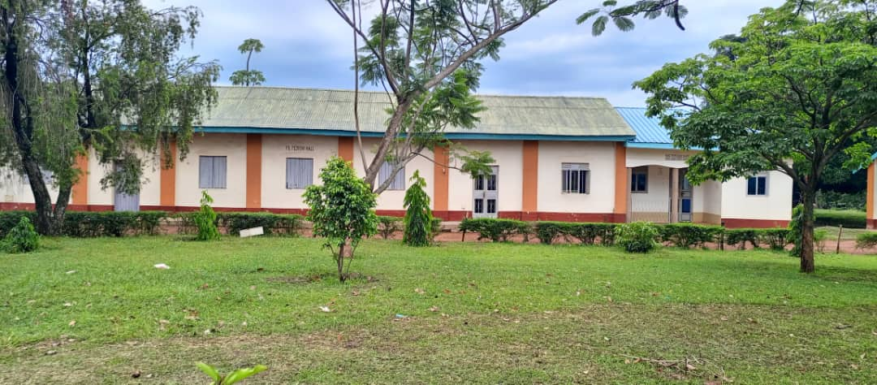
ECD RESOURCE ROOM

Slide 60
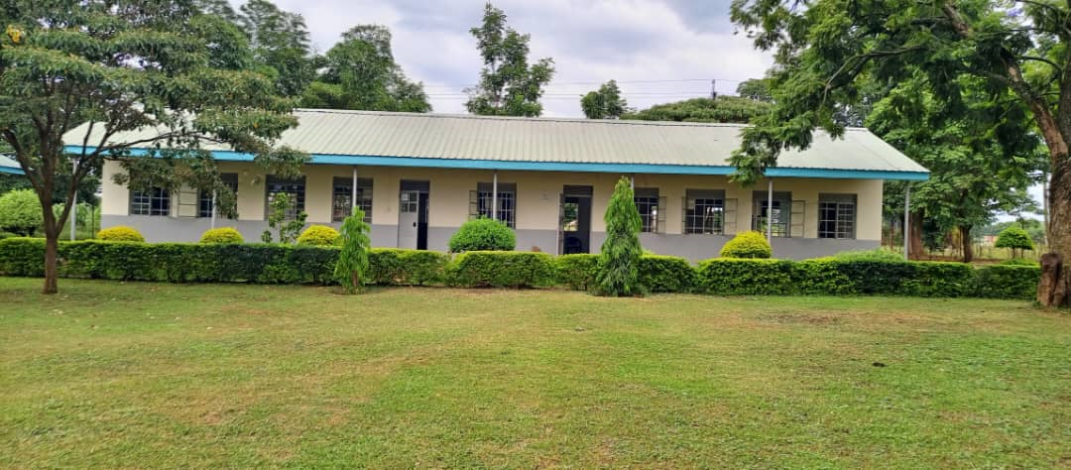
SCIENCE LABORATORY

Slide 61
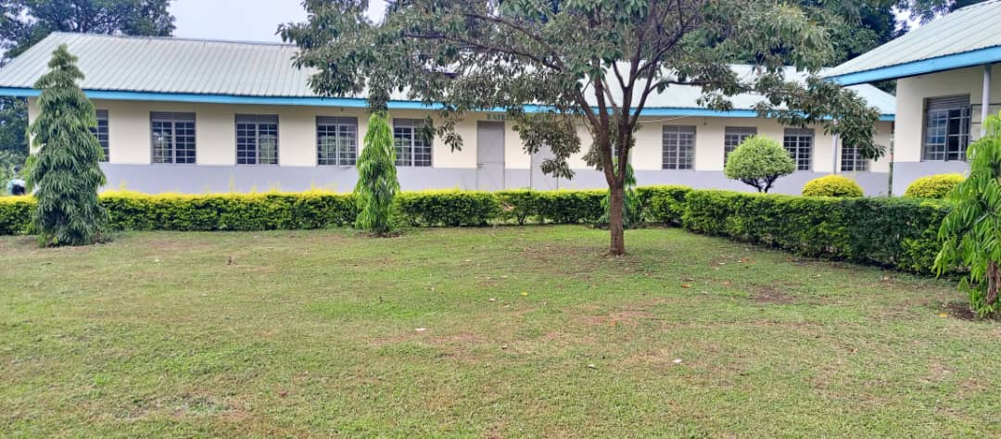
CLASSROOMS AND SCIENCE LABORATORY

Slide 62
MORE ARE TO COME, ESPECIALLY THE INTERNAL APPEARANCE

